Slide 1
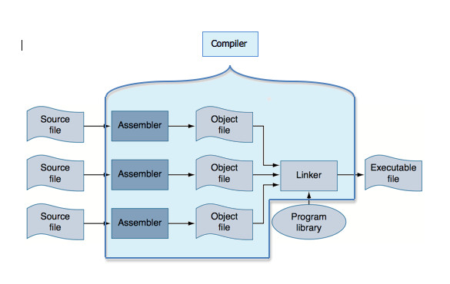
Multi-Module Programs
Notes:
Every C program must have a main function but it can also contain other functions.

Slide 2
Multi-Module Programs
Modularize your programs even more
Instead of a large program consisting on one large file, it can be broken up into smaller modules
Each module consisting of a single function or group of related functions
Notes:
Many times, large programs are written by a group of people, each person or team responsible for one part (module) of a larger program.
Example of group of related functions – may have an arrayInit.c file that contains several different types of initialization functions:
from user input
using rand()
even numbers within given range
odd numbers within given range
prime numbers starting at given starting value
etc
Could also have arraySorting.c that contains several different types of sorting functions

Slide 3
Compiling Multi-Module Programs
All the .c files are compiled at the same time using gcc, for example:
gcc –Wall –o arrayProg main.c arrayInit.c arraySort.c
You can see that a makefile becomes especially helpful when there are multiple files to be compiled
Notes:
In the example, the executable name would become “arrayProg” and would consist of those 3 .c files compiled together.
Use of makefile is even more desirable with multiple files. If any of the files had compilation errors, you will see a list of all the errors and which file(s) they come from; then when fix the errors and re-compile with make, only those files that had the errors that you fixed would need to be re-compiled.
Show example…

Slide 4
Compiling Multi-Module Programs
Preprocessor first sub-step of compile, taking care of #directives in each source file
Assembler is next step, creating assembly language version for each source file (.s file, one-to-one correspondence with machine language)
From each assembly language file, an object file is produced (.o file, binary code)
Linker is the next step: each .o file + whatever library files that are included are all combined into one executable file called a.out

Slide 5
Compiling Multi-Module Programs
These intermediate files are automatically deleted by the system after the compilation process ends. To keep those intermediate files, can compile with the –save–temps flag with gcc:
gcc –Wall –o arrayProg –save–temps main.c arrayInit.c arraySort.c
Notes:
See how much longer the gcc line is becoming? You can even add the –g flag for debugging purposes.
Much easier to use a makefile.

Slide 6
External Variables
Functions contained in separate files can communicate through external variables.
Global variables are external variables.
Notes:
Global variables are external variables – they are accessible by other functions in other files – that’s why you typically should not use global variables unless you specifically need that variable to be shared across files.

Slide 7
Declaring External Variables – Approach #1
Declare global variable as you normally would at top of file where it first appears (can initialize too)
In other file where that will be used, at the top of the file or inside the function where it will be used, you would declare it again using the extern keyword
In main.c, declare global variable int numItems = 0;
In other file, at top declare extern int numItems;

Slide 8
Declaring External Variables – Approach #2
Declare global variable at top of all files that use it using extern keyword
It must be initialized at one of those declarations (the file that first uses the variable)
In main.c, at top of file extern int numItems = 0;
In other files, at top declare extern int numItems;

Slide 9
Static vs Extern
Global variables are also extern variables.
If you have a global variable that you don’t want to be accessed by functions in other files, you can declare it with the static keyword:
At top of file static int numItems = 0;
numItems would be available to all the functions in that file, but not to other functions in other files.
Notes:
So, variables declared outside of any functions are not only global but also extern variables.

Slide 10
Static vs Extern
Same goes with functions – when a function is defined, by default, it is an extern function; it is available to other functions in other modules.
To restrict the accessibility to only the file where it is implemented, put the static keyword in front of it:
static int minValue(int theArray[], int size) {
// code for this function
return minimum;
}
Notes:
So, variables declared outside of any functions are not only global but also extern variables.

Slide 11
Header Files
The #include statements that you have been using are to include header files from the C library, e.g. stdio.h
You can make your own header files and #include those in your program as well at the top of every file that needs it.
What goes in a header file?????
All your other #include statements
Any shared (global, extern) variables
All your #define statements
Function prototypes
Notes:
What is #define?
(pages 297+ in book)
One of the primary uses for the #define is to assign symbolic names to program constants. Think of it as a “text substitution”, a “copy-and-paste” performed by the pre-processor.
Example:
#define YES 1
Will copy the value 1 into every location in the file where ever the word YES appears. It is not a variable, so other values cannot be assigned to YES – the pre-processor just copies and pasts the value 1 into those locations as if you had just typed 1.
Program 12.1 page 298

Slide 12
Header Files
What does NOT go in a header file?????
Function implementations
Notes:
Show example…

Slide 13
Why Use Header Files?
Cleans up and simplifies readability of source files
Provides a means of standardization for large programs that are developed by multiple programmers
Notes:
Makes it easier for all the programmers who are working on the same program to see all the shared variables, #define names, function prototypes, and other #include statements – they are all using the same definitions and names of things

Slide 14
Header Files
When you #include your own header file, the file name goes in quotes instead of angle brackets, at the top of all the files that need something from that header file.
The pre-processor then looks in the current directory for a file by that name and effectively copies the contents of the file into the program at that precise point where the #include statement appears.
// top of main
#include <math.h>
#include “myDefs.h”
Notes:
If you forget, and use angle brackets, the compiler looks in a lower level location where all the other provided C library files are located

